Slide 1
Firmware Reverse Engineering

Slide 2





Hi!
I am Satria Ady Pradana
Community Leader
of
Reversing.ID
xathrya
https://xathrya.id
@xathrya
Reversing.ID
Revealing the Truth through Breaking Things

Slide 3
Disclaimer
This presentation is intended for educational purposes only.
Reverse engineering of copyrighted material is illegal an might cause you a direct or indirect consequence. We have no responsibility of anything you do after learning this.

Slide 4
What is Firmware?
Software that provides low-level control for the device’s specific hardware.
Single or collection of specialized software
Mostly embedded on hardware, stored on specific region (ex: ROM), and executed on closed environment (only on that hardware).

Slide 5
Common Embedded Device Classes
Networking – Routers, Switches, NAS, VoIP phones
Surveillance – Alarms, Cameras, CCTV, DVRs, NVRs
Industry Automation – PLCs, Power Plants, Industrial Process Monitoring and Automation
Home Automation – Sensor, Smart Homes
Entertainment – TV, DVRs, Receiver, Stereo, Game Console, MP3 Player, Camera, Mobile Phone, Toys
Other Devices – Hard Drives, Printers
Cars
Medical Devices

Slide 6
What do you think of
Reverse Engineering?

Slide 7
Explaining Reversing
Originally used in the context of mechanical engineering
Breaks down an existing object or system to its construction and then rebuild it based on new demand.
Extracting knowledge or design information from anything man-made and reproducing it or reproduce anything based on the extracted information.

Slide 8
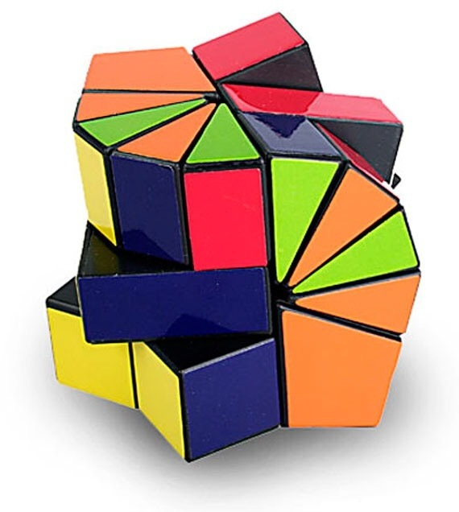
Reversing = Solving Puzzles

Slide 10
Type of Firmware
Bare-metal firmware
A single program, single layer.
No operating system.
Direct access and full control of low-level hardware.
Primitive operations (ex: spin the disk for X degree clockwise).
Typically used for specific hardware, such as hard disk, motherboard, etc.
Full firmware
One or more application, multiple layer.
Include an embedded operating system (ex: linux)
Higher level of operations (ex: handle routing protocol)
Typically used for appliance, such as router, IoT hardware, etc.

Slide 11
This session will be limited to Full Firmware.
Reversing bare-metal firmware will require more knowledge about hardware.

Slide 12
Ecosystem of Firmware (Development)
Toolchain (compiler)
Kernel
File System
Application
Bootloader
Full Firmware is bundle of bootloader, kernel, file system, and application.

Slide 13
Common Reversing Steps
Information gathering
Acquire the firmware
Extract
Analysis & Modification
Repackage

Slide 14
Common Tools
File Format Identifier (and Parser)
Binwalk, file
Extractor
Squashfs-tools
Disassembler
IDA, Radare2
Emulator
Cross toolchain
Packager

Slide 15
1. Information Gathering
What to search?
File format
Architecture
Hardware feature
Some information source
Datasheet
FCC specification

Slide 16
Common Architecture
x86 / x86_64
ARM
MIPS
8051
Atmel AVR
Motorola 6800/68000 (68k)
Different processor architecture leads to different machine code and thus different tools.

Slide 17
2. Firmware Acquisition
Dump from hardware
Sniff the firmware-update mechanism
Download the firmware
Remember to analyze the firmware

Slide 18
3. Firmware Extraction
Extraction means unpack the firmware and get all the contents of firmware.
Remember that full firmware consists of many components!
Different format / structure has different strategy.
Need to preserve the content, no loss and no noise.

Slide 19
4. Analysis & Modification
Search for this and that
Backdoor from manufacturer.
Vulnerability?
Patch here and there
Create backdoor
Hidden operation
Nullify some features

Slide 20
5. Repackage
Put the content back to a package
Different structure has different tools.

Slide 21
DEMO !!!

